Slide 1

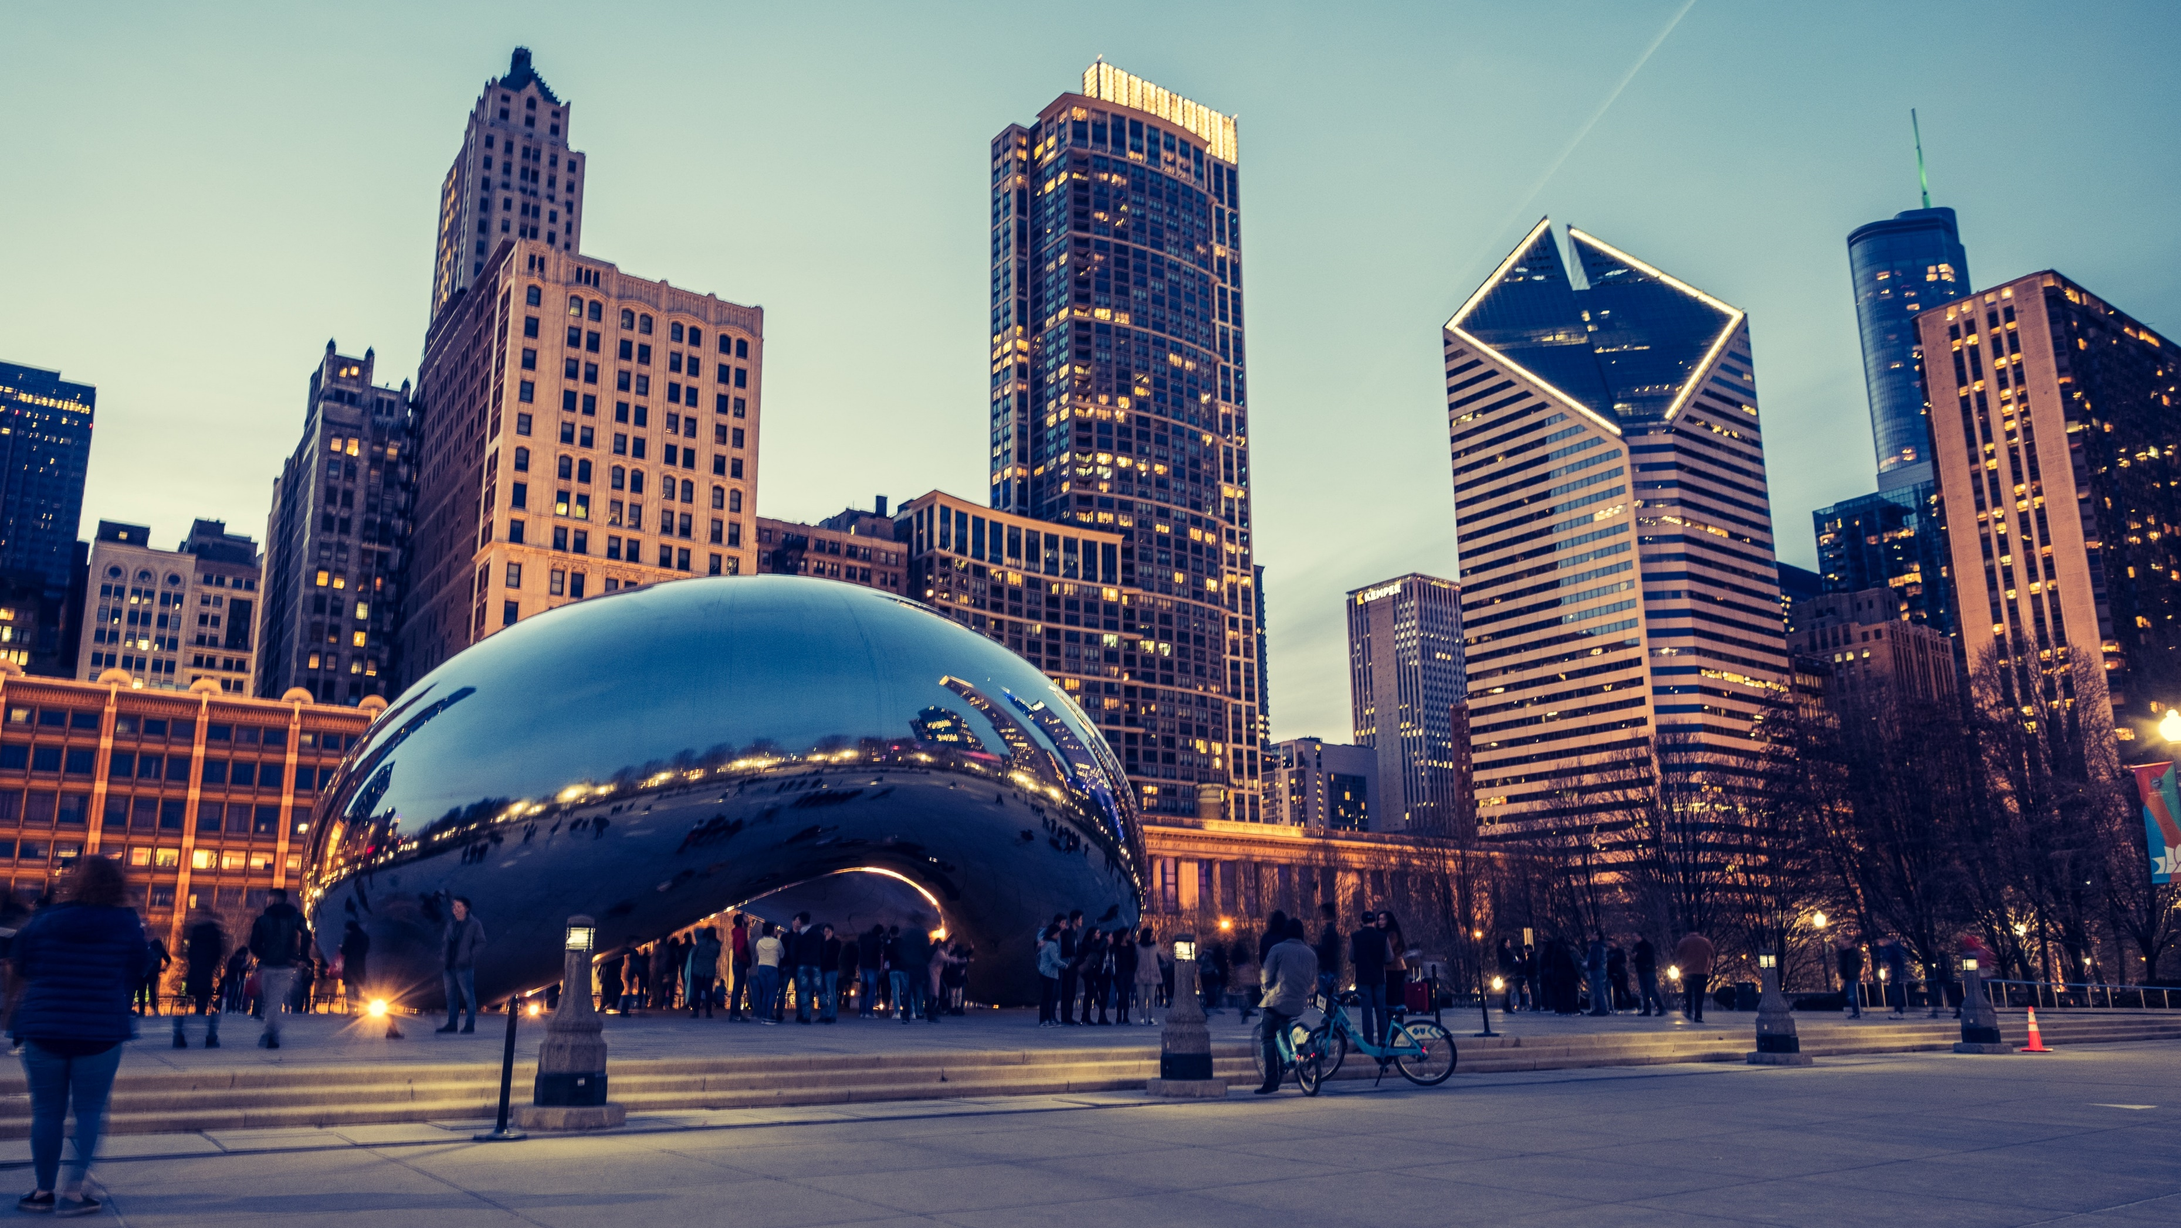
Determining an Ideal Korean Restaurant Location in Chicago, Illinois
presented by Sun Jae Lim

Slide 2
Introduction
According to the City of Chicago, Chicago, Illinois is the third largest city in the United States. With a large city comes a large population! With over 7,000 restaurants present, Chicago presents a ripe opportunity for businesses interested in the food service industry
But how robust is the food industry? The National Restaurant Association predicts a projected restaurant industry revenue of nearly $899 billion for 2020, an increase of $36 billion compared to 2019.

Slide 3
Business Problem
The Problem:
Suppose we want to setup a Korean restaurant in Chicago, Illinois. Which neighborhood or area would be the ideal location? Are there multiple ideal locations?
Factors to consider include nearby venues, potential competition, population and access to transportation.
Who this interests?
The results of this project would be useful for Korean restauranteurs seeking to expand into Chicago, Chicago city planners, or food enthusiasts seeking areas with popular Asian venues

Slide 4
Data
Neighborhood and community area data will be scraped from the following Wikipedia page: https://en.wikipedia.org/wiki/List_of_neighborhoods_in_Chicago.
Chicago community area demographic data for 2014 to 2018 will be obtained from the CMAP Data Hub website: https://datahub.cmap.illinois.gov/dataset/community-data-snapshots-raw-data/resource/8c4e096e-c90c-4bef-9cf1-9028d094296e.
Geopy used to extract coordinates for each community area.
Foursquare API used to collect categorical information on venues near each community area.
Libraries used to clean and organize data include pandas and NumPy.

Slide 5
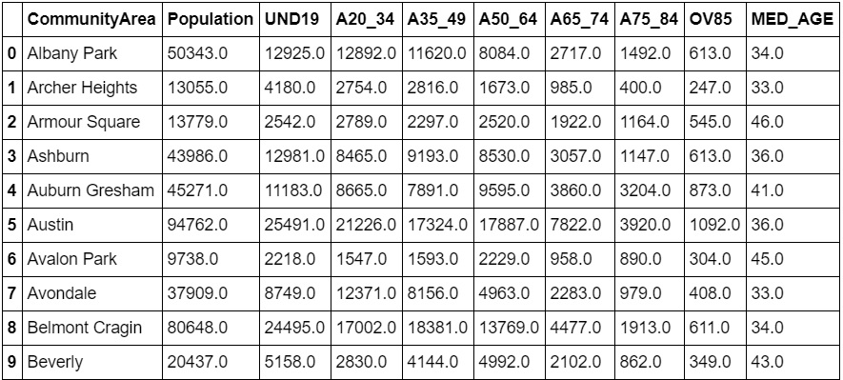
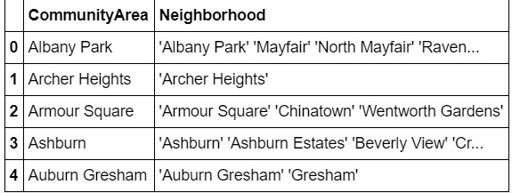
Examples for sorting preliminary data
Neighborhoods grouped into 77 community areas due to historic unreliability of neighborhood segments.
Community areas are static, have defined borders, and are used for statistical purposes (Community areas, in Chicago 2020)
Chicago community area demographics were edited to only include age groups and total population.
Columns renamed to ‘CommunityArea’ and ‘Population’

Slide 6
Methodology Overview & Results
Part 1: Population Comparison with pandas
Top 10 most populated areas ; top 10 youngest areas ; top 15 youngest areas
Part 2: Examining Venues and k-means clustering using scikit-learn
Clustered with k = 5 and k = 10 ; compiled a list of possible candidates based on popular venue
Part 3: Visualizing and mapping data with folium and matplotlib
Visible cluster patterns ; comparing possible candidates and locations

Slide 7
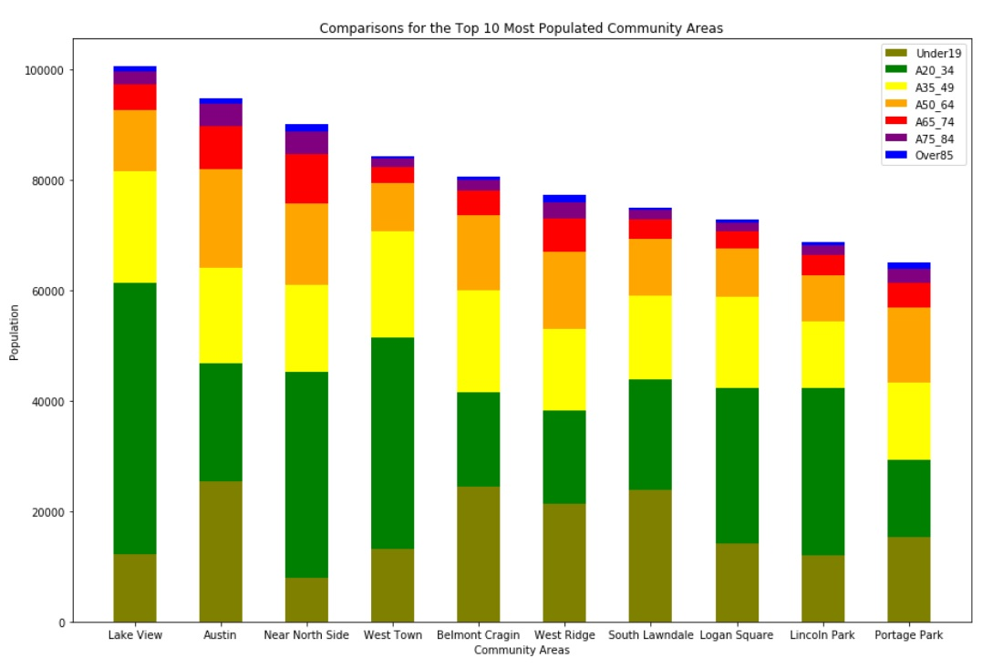
Population Comparison : Stacked bar graph of top 10 most populated areas
Lake View was the most populated with 100,547 total population
Areas such as Austin, Near North Side, West Ridge, and Portage Park had higher senior population (>50 years of age)
Another comparison was performed with the top 15 youngest community areas

Slide 8
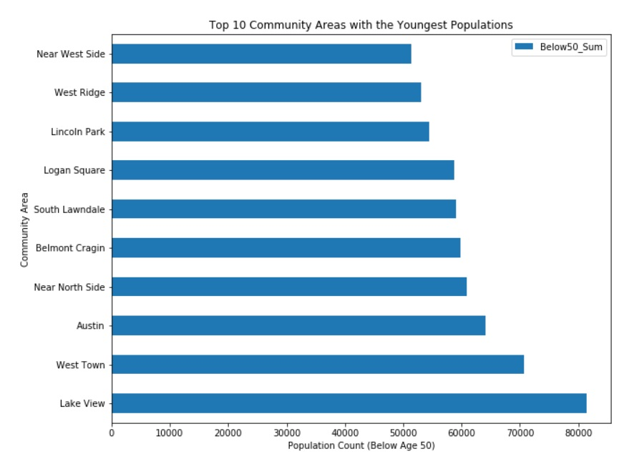
Population Comparison: Top 10 areas with the largest number of young individuals (<50 years)
Portage Park is not within the top 10 anymore. Replaced with Near West Side. This means Portage Park has a higher overall population, but less young individuals compared to Near West Side.
West Ridge has a small amount, meaning the total population has a large older demographic
West Town moved up, indicating a higher younger population count compared to both Near North Side and Austin

Slide 9
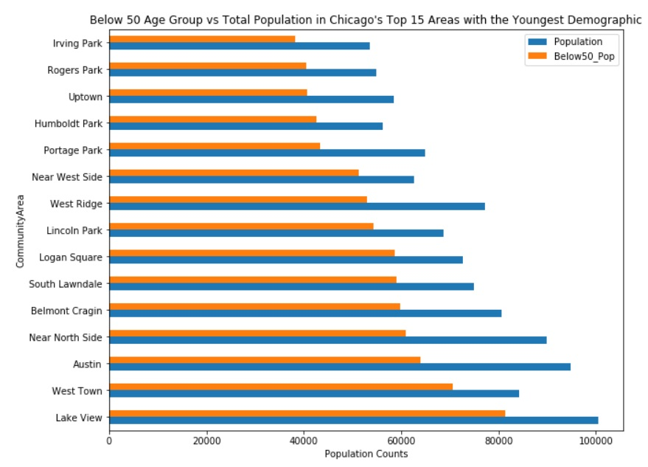
Population Comparison : Bar graph of top 15 youngest areas
Even among the top 15 areas with the highest youngest population count, Lake View was the best candidate
In general, the areas with the largest amount of young individuals (<50 years of age) were also areas with the largest total population
The exception was Portage Park, which was the only area which fell out of the top 10 rankings. Near West Side replaced Portage Park.

Slide 10
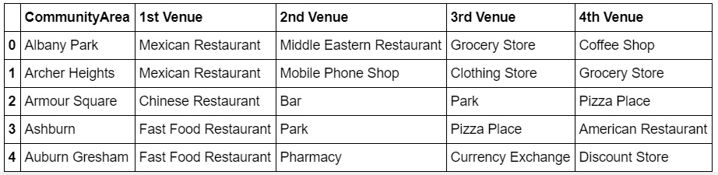
Examining the top 4 venues per community area
No nearby venues within 500 meters for Riverdale and South Deering. It can be assumed these locations are in more rural areas or further away from any popular areas. The Loop had 100 venues nearby or more, due to being a large business district.
Expanding the search radius to 1000 returned 4 venues for South Deering and 3 for Riverdale.
Community areas with popular Korean restaurant venues: North Park
Community areas with Chinese, Japanese, Vietnamese, Asian, Indian or Pakistani restaurants in top 4 venues: Armour Square, Bridgeport, Chatham, Near South Side, Hegewisch, Uptown, West Lawn, Edgewater, & West Ridge
Community areas with taxis, bus stops, or train stations : East Garfield Park, Fuller Park, Pullman, West Garfield Park, Riverdale, Grand Boulevard, North Park, & Morgan Park

Slide 11
K means clustering and trends
Cluster 0: Washington Heights, Ice Cream Shop as the top venue
Cluster 1: 25 community areas, usually with a bar or coffee shop as the top venue
Cluster 2: 13 community areas, a majority had train or bus stations as their top venues
Cluster 3: 5 community areas, with Mexican restaurants as their top venue
Cluster 4: 6 community areas, with most having Fast Food restaurants as their top venue
Cluster 5: Riverdale, with a clothing store as the top venue
Cluster 6: Morgan Park, with a BBQ join as the top venue
Cluster 7: Oakland, with beach as the top venue
Cluster 8: South Deering, top venue is a golf course
Cluster 9: 23 community areas, usually with a Fast Food or Mexican restaurant within the top two venues

Slide 12
K means clustering and trends
Cluster 4 would be more accurate if areas like Calumet Heights, Douglas, and North Lawndale from Cluster 2 were included
Grand Boulevard from Cluster 2 may be better suited to Cluster 6. BBQ join as top venue.
Cluster 9 has areas which would fit Cluster 3 better due to Mexican restaurant popularity
Cluster 6 and 7 are both known for their BBQ, but Morgan Park is located at the outer edge of Chicago and Oakland is more central. Our folium map confirms Oakland is right by Lake Michigan.

Slide 13
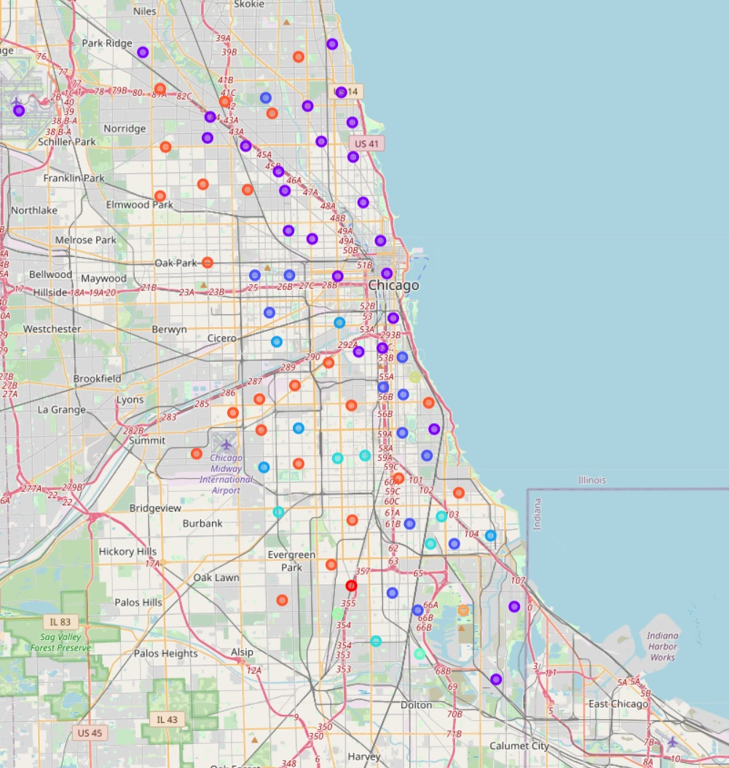
Visualizing the total clusters
Clusters appeared to mostly be divided by location
Cluster 1, in purple, ran alongside the North part of Chicago near the Kennedy Expressway.
Mostly bars or coffee shops.
Cluster 2, in dark blue, runs from the top to the bottom
Trains or bus stations
Cluster 9, in red-orange, was mostly towards the west side of Chicago. Note the line of areas running horizontally along Stevenson Expressway.
Fast Food or Mexican restaurants
Clusters 3 and 4, in tints of blue. Also near the Stevenson Expressway.
Fast Food and Mexican restaurants
Cluster 7 has the Oakland Beach. This is the top venue.
Clusters 5, 6 and 8 were all towards the southern part of the city.

Slide 14
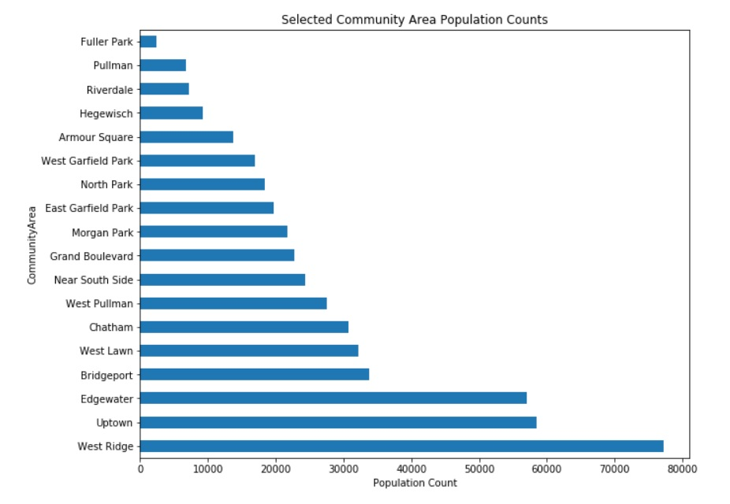
Visualizing candidates
West Ridge has the highest population with close to 80,000 residents. Recall it was also in the top 10 most populated areas.
Uptown and Edgewater have roughly similar populations of 55,000+
Every other candidate selected has less than 40,000 population
Given that population is a large driving factor in business, West Ridge is our best choice

Slide 15
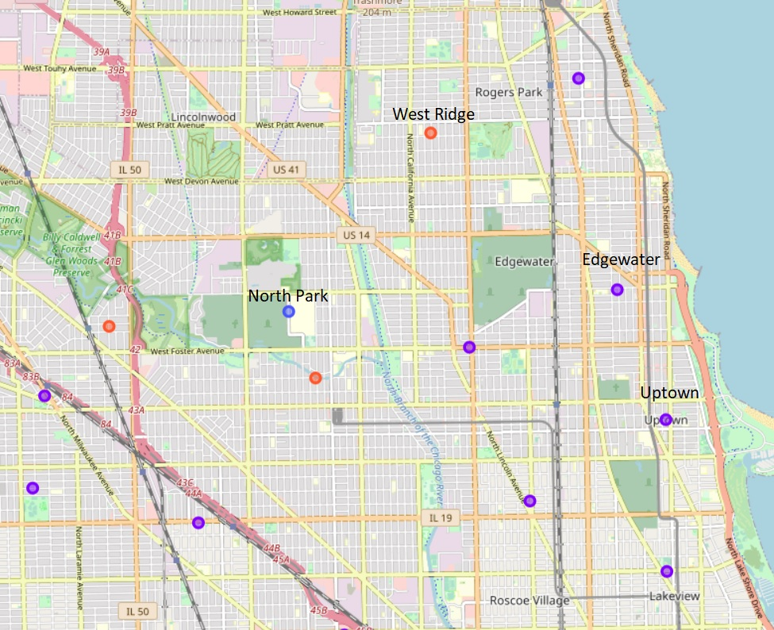
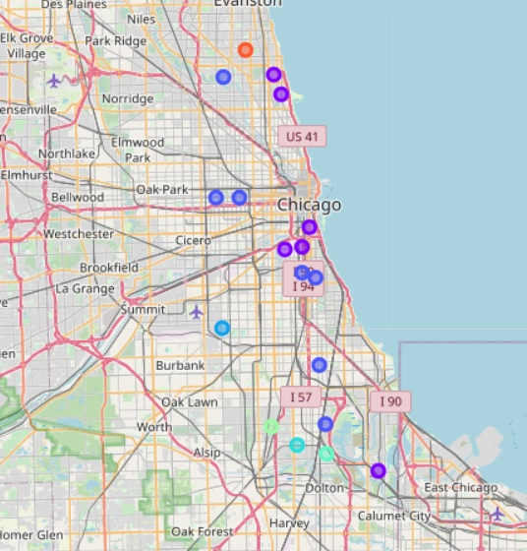
Visualizing candidates
North Park had a Korean restaurant as one of its top 4 venues
West Ridge is very close to North Park, meaning interested parties will not have to drive far to seek Korean food or transporation.
West Ridge has well known Indian and Pakistani restaurants.
Edgewater and Uptown are close to eachother, but Uptown has more well-known Asian venues in its top 4 (Vietnamese and Chinese).
Zoomed in view of our top three candidates (West Ridge, Edgewater, & Uptown)
Mapped view of all potential candidates.

Slide 16
Conclusion
Both population and being near an established area for Asian food would be beneficial for setting up a Korean restaurant.
West Ridge is the top pick due to it’s high population, established Asian food venues, nearby transportation, and for being near an area with an established, popular Korean venue (North Park).
Uptown with a smaller population, but popular Vietnamese and Chinese venues is the second choice.
Edgewater is the third choice, with only one popular Asian venue and a smaller population than Uptown.
Limitations:
Investigations into specific neighborhoods would be more beneficial given current data. Census data from 2020 would also be more helpful to pinpoint demographic accuracy. Foursquare API will change over time and future investigations may yield different results.

Slide 17
Works Cited
General Sources:
Chicago Metropolitan Agency for Planning. (2020). Chicago Community Area (CCA) CDS data. [Data set]. CMAP Data Hub. https://datahub.cmap.illinois.gov/dataset/community-data-snapshots-raw-data/resource/8c4e096e-c90c-4bef-9cf1-9028d094296e
Chicago Loop. (2020, July 20). In Wikipedia. https://en.wikipedia.org/wiki/Chicago_Loop
City of Chicago (2010 – 2020). Facts & Statistics. Chicago.gov. Retrieved July 18, 2020, from https://www.chicago.gov/city/en/about/facts.html
Community areas in Chicago. (2020, May 30). In Wikipedia. https://en.wikipedia.org/wiki/Community_areas_in_Chicago
List of neighborhoods in Chicago. (2020, June 4). In Wikipedia. https://en.wikipedia.org/wiki/List_of_neighborhoods_in_Chicago
National Restaurant Association. 2019 Restaurant Industry Factbook. Restaurant.org. https://www.restaurant.org/downloads/pdfs/research/soi/restaurant_industry_fact_sheet_2019.pdf
National Restaurant Association. National Statistics. Restaurant.org. Retrieved July 18, 2020 from https://restaurant.org/research/restaurant-statistics/restaurant-industry-facts-at-a-glance
Introductory Image:
Anderson, Lance. (2018) Free Chicago Image on Unsplash. Unsplash. https://unsplash.com/photos/uevmkfCH98Q.

